Slide 1
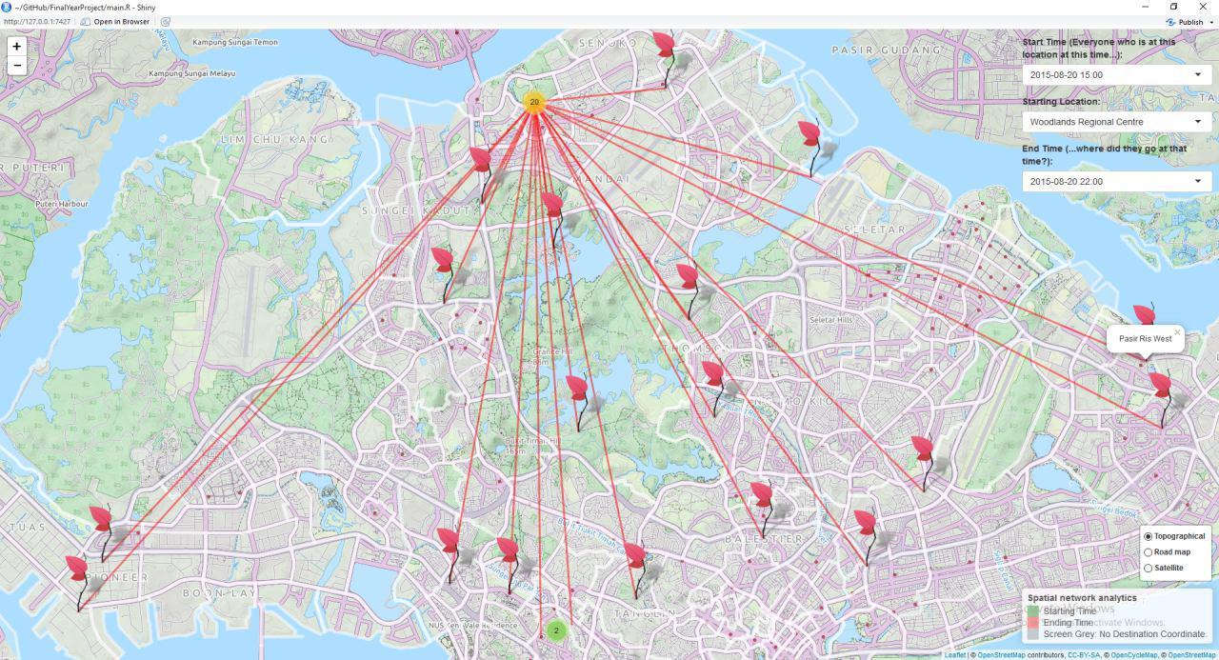
StarHub: Spatial network analytics [Data Analytics & Visualisation] Partner Organisation: Starhub
Project Overview
The project: The project main focus is to transform the data, given by Starhub, to represent and show to the user how the people using Starhub mobile network are moving in Singapore. Also, we did a script to allow automation of uploading large sum of data to database.
Key technologies: Rstudio and Python.
Students:
Lee Guan Yan
Tnay Teng Long
Ong Sze Ching
Supervisor:
Mr Ho Chee Wai
Notes:
NOTES
Refer to write ups in ‘Past Projects for Reference’ Booklet for Project overview write ups - http://yoda.soi.rp.edu.sg/wiki/index.php/FYP_Wiki
ENGLISH - British Eg. organisation VS organization
Font: RP approved font - Arial family only.
Header: Arial Bold
Copy text: Arial regular or Arial Bold. Use Emphasis of our SOI orange in moderation.
Picture frame – Give a 4.5 or 6pt orange outline.

